Slide 1
Introduction to the concept of
Cell Referencing : Fixed
Content:
Brief explanation of why fixed cell referencing is important in excel.
Overview of how fixed cell references can be used to keep specific cells constant in formulas, even when copying or dragging them to other cells.

Slide 2
A cell reference refers to a cell or a range of cells on a worksheet and can be used in a formula so that Excel can find the values or data that we want that formula to calculate.
Fixed cell referencing is a powerful feature in Excel that allows us to keep specific cells constant in formulas, regardless of where they are copied or dragged within a worksheet.
When the formula is copied or dragged horizontally or vertically, the reference to cell (say,C1) remains constant. However, the reference to cell (say,B2) changes relative to the new location of the formula.
This ensures that the any data, specified in cell C1, remains consistent across all calculations, regardless of their position within the worksheet.

Slide 3
Benefits of Fixed Cell Referencing:
  Provides stability and accuracy in calculations, especially when working with large datasets or complex formulas.
  Saves time by preventing the need to manually adjust cell references in formulas.
Best Practices:
  Use fixed cell referencing for values that should remain constant throughout your calculations, such as tax rates, commission rates, or other constants.
Let's consider an example where we have a table of salary of employees with the following formula to calculate the tax rate:
  =B2 * $F$2
  In this formula, $F$2 is a fixed cell reference. It always refers to cell F1, even if the formula is copied or dragged to other cells.

Slide 4
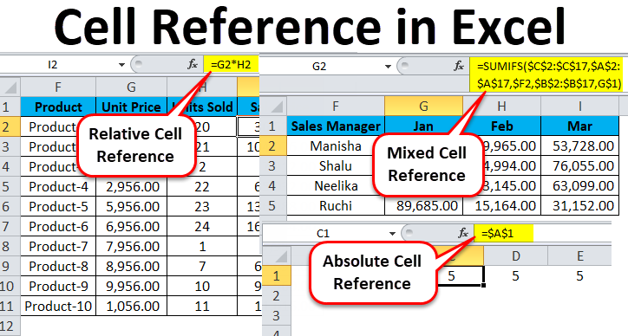
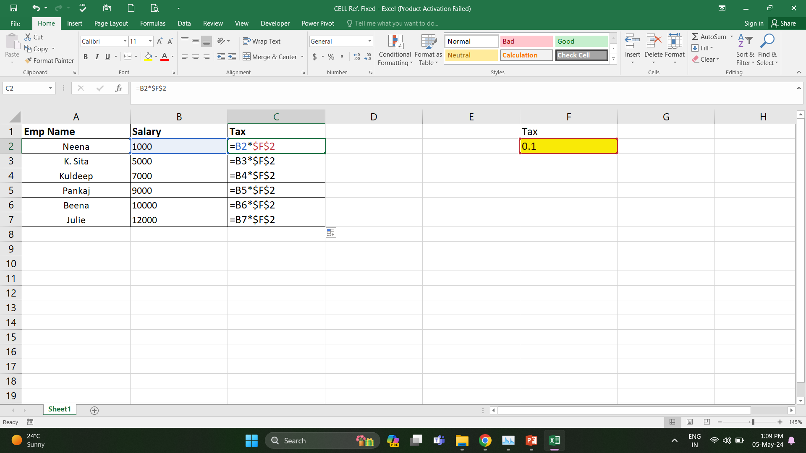
Examples of Cell Referencing:
Fixed Cell Ref.

Slide 5
Thank you.

